Slide 1

CS-866 Information Visualization
Course Project Presentation
Presented by: Nikahr Azhar, Huma Ameer, Saher Sohail, Fasih Ashfaq and Usama Naveed

Slide 2
Data Introduction
The data set we are using is the primary World Bank collection of development indicators, compiled from officially-recognized international sources. It presents the most current and accurate global development data available, and includes national, regional and global estimates.
It is available at : https://www.kaggle.com/manchunhui/world-development-indicators#

Slide 3
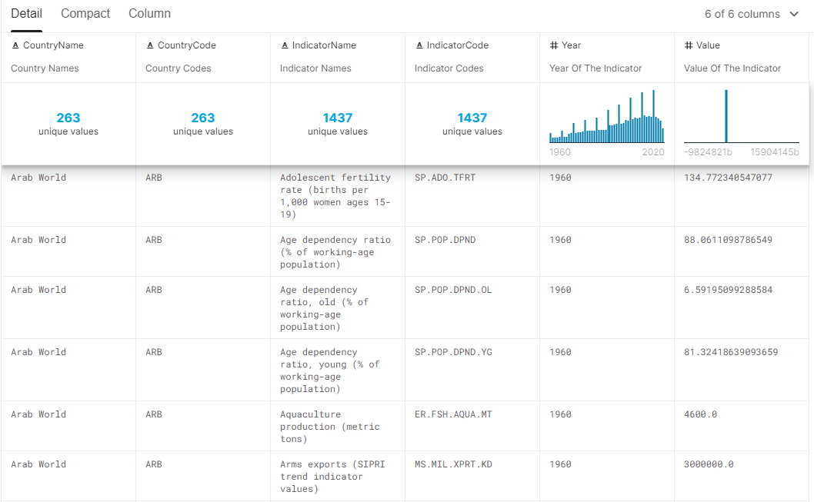

Slide 4
Chosen Indicators
Arms Imports
Mobile Cellular Subscription
New Businesses Registered
Population
Refugee Population by Country or Territory of Origin

Slide 5
What–Why–How Analysis Framework

Slide 6
Data Abstraction What?
Data and Dataset type
Table:
Items
Attributes
Classification of Attributes
Categorical:
Country Names
Indicator Names
Indicator Codes
Country Codes
Ordered:
Year (Year of Indicators)
Value (Value of the indicators)
Dataset Type
Data Types
Ordinal (Sequential)
Quantitative (Diverging)

Slide 7
Task Abstraction Why?
Actions
Analyze:
Consume
Present
Discover
Produce
Derive – Rank Attribute
Annotate – Year value
Search:
Locate
Explore
Query:
Identify
Compare
Summarize
Targets
All data:
Trend
Feature (specific aspect such as averaging)
Attribute:
Distribution

Slide 8
Encode How?
World Map
Marks :
Area
Channel:
Position – Spatial
Size – Area
Color – Saturation
Racing Bar Chart
Marks:
Straight lines
Channel:
Position – Vertical
Size – Length
Color – Hue

Slide 9
Facet How?
Juxtapose
Data – All
Encoding – Different
Share Encoding – Linked Highlighting
Racing bar chart and World map shown side by side on the Tableau Dashboard for each indicator linked through highlighting.
Multiform

Slide 10
Reduce – Filtering How?
Arms Imports
Racing Bar Chart
Rank
Country name
Year
World Map
Country name
Year 2019
Mobile Cellular Subscriptions
Racing Bar Chart
Rank
Country name
Year
Indicator name
World Map
Country name
Indicator name
Year 2019
Measure: Average for all Indicator Values

Slide 11
Reduce – Filtering How?
New Businesses Registered
Racing Bar Chart
Rank
Country name
World Map
Country name
Year 2019
Population
Racing Bar Chart
Rank
Country name
Year
World Map
Country name
Year 2019
Measure: Average for all Indicator Values

Slide 12
Reduce – Filtering How?
Refugee Population by Country or Territory of Origin
Racing Bar Chart
Rank
Country name
Year
World Map
Country name
Year 2019
Measure: Average for all Indicator Values

Slide 13
Manipulate How?
Navigate
Select
Change
Zoom
Pan
Sort

Slide 14

Justification of Design Choices World Map
Maps portray the information in a better manner for each country on the globe.
Maps have a greater ability to more easily portray the distribution of an entity's presence across the city, state, or country.
They have the ability to compare the activity across several locations at a glance.
Maps lead to more intuitive decision making and contextualized your data in the real world.

Slide 15

Justification of Design Choices Racing Bar Chart
Easy to read, they provide a clear visual impression.
They allow ease in comparison interpretation.
The racing animations keeps the user’s interest while showing change over time (in this case years).
Bar charts have been in widespread use all over from textbooks to daily papers, most groups of onlookers understand how to study a bar chart and can get a handle on the data the chart passes on.
It shows each data category in a frequency distribution and displays relative numbers or proportions of multiple categories.
It summarizes a large dataset in visual form.

Slide 16
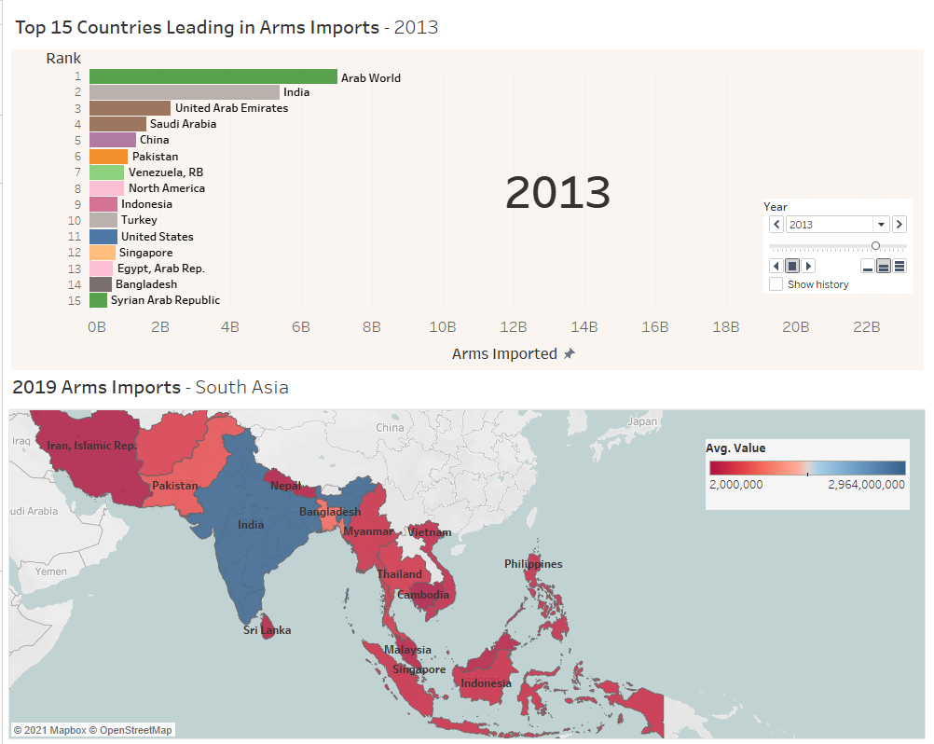
Notes:
Arms Imports
M. Fasih Ashfaq

Slide 17
Results Arms Imports
1990
1st – India
2nd – Japan
3rd – Saudi Arabia
Pakistan – 14th
2019
1st – Saudi Arabia
2nd – India
3rd – Qatar
Pakistan – 15th
South Asia (2019)
1st – India
2nd – Bangladesh
3rd – Pakistan
Lowest - Cambodia
Insight: Countries with more arm imports are those with warzones/ conflict zones and have more crime rate.

Slide 18
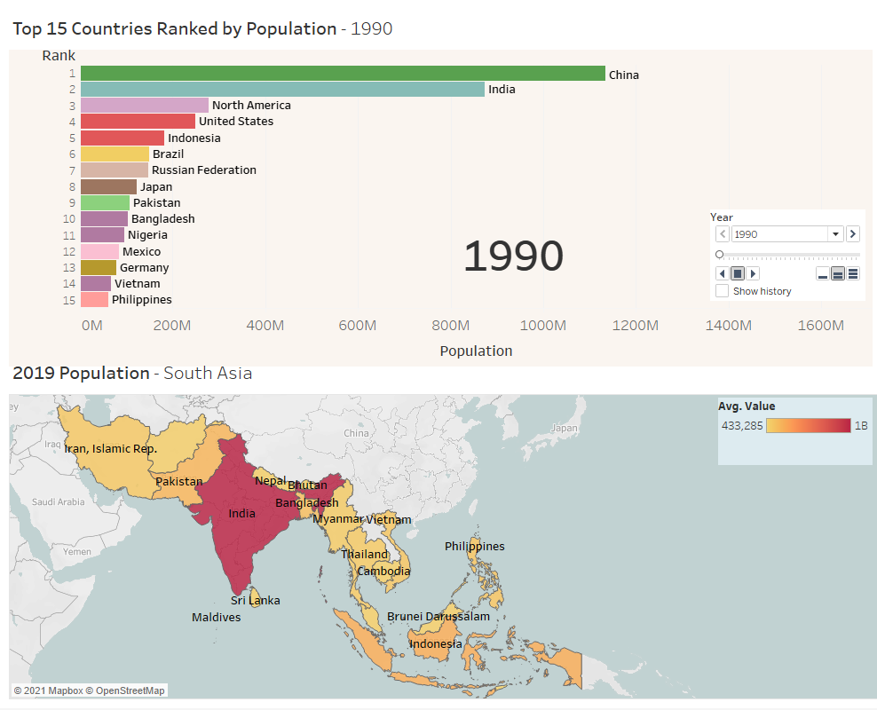
Notes:
Population
Huma Ameer

Slide 19
Results Population Index
1990
1st – China
2nd – India
3rd – US
Pakistan – 9th
2019
1st – China
2nd – India
3rd – US
Pakistan – 6th
South Asia (2019)
1st – India
2nd – Indonesia
3rd – Pakistan
Lowest - Brunei
Insight: China, India, and US retained their positions. On the other hand Pakistan raised from 9th to 6th position which is quite alarming.

Slide 20
Machine Learning
Machine learning is an art of getting computers to learn and solve complex real world problems.
Population of Pakistan till year 2030 was predicted using the linear regression. As population data is continuous so linear regression is the best technique to use and predict future population.
By predicting the future population we can fulfill our future water and electricity needs.
Like how much water will be required for the population count of year 2030 if it was ‘x’ in year 2019.

Slide 21
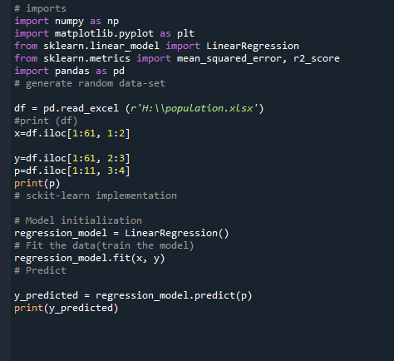

Slide 22
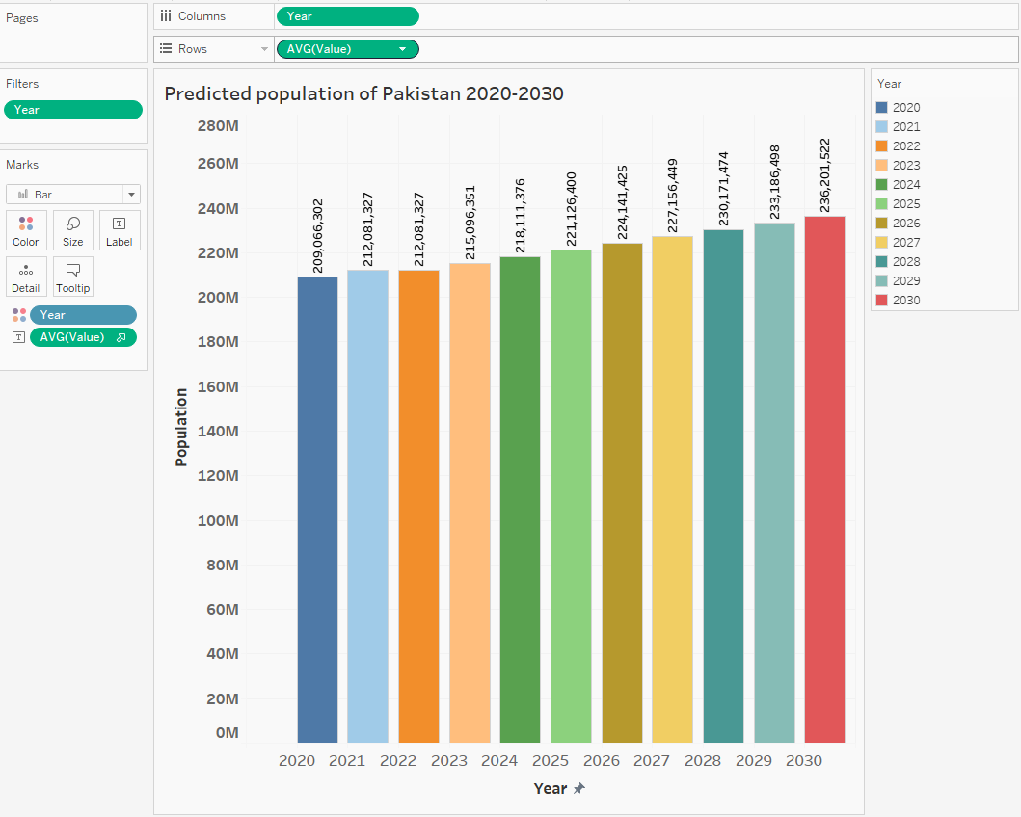

Slide 23
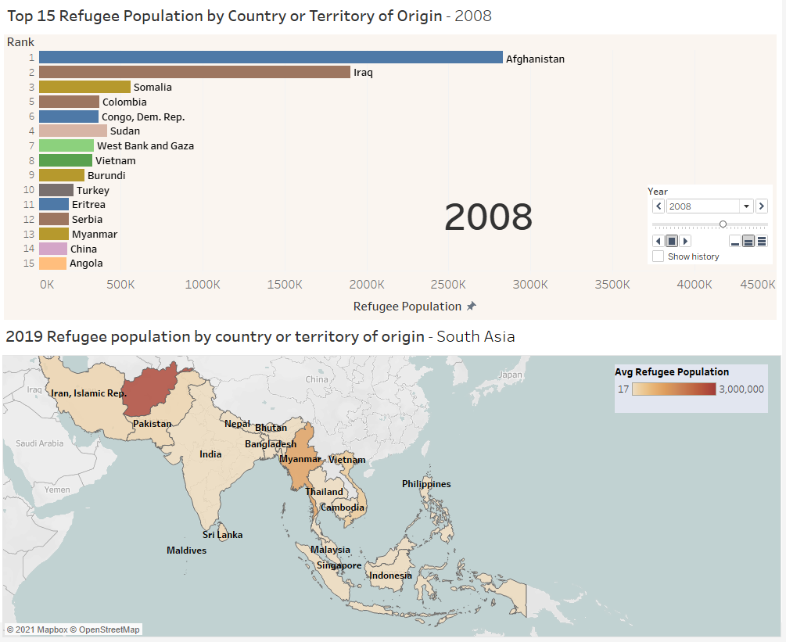
Notes:
Refugee Population By Country or Territory of Origin
Nikhar Azhar

Slide 24
Results Refugee Population
1990
1st – Afghanistan
2nd – Ethiopia
3rd – Mozambique
Pakistan – Not in top 15th
2019
1st – Syria
2nd – Afghanistan
3rd – South Sudan
Pakistan – Not in top 15th
South Asia (2019)
1st – Afghanistan
2nd – Myanmar
3rd – Vietnam
Lowest - Singapore
Insights: We can observe Afghanistan has been a country with most refugees through out the 30 years time span which is understandable since it has been in a state of conflict for many years. We can see that all leading countries with the highest number of refugees have states that are or were war zones or conflict zones.

Slide 25
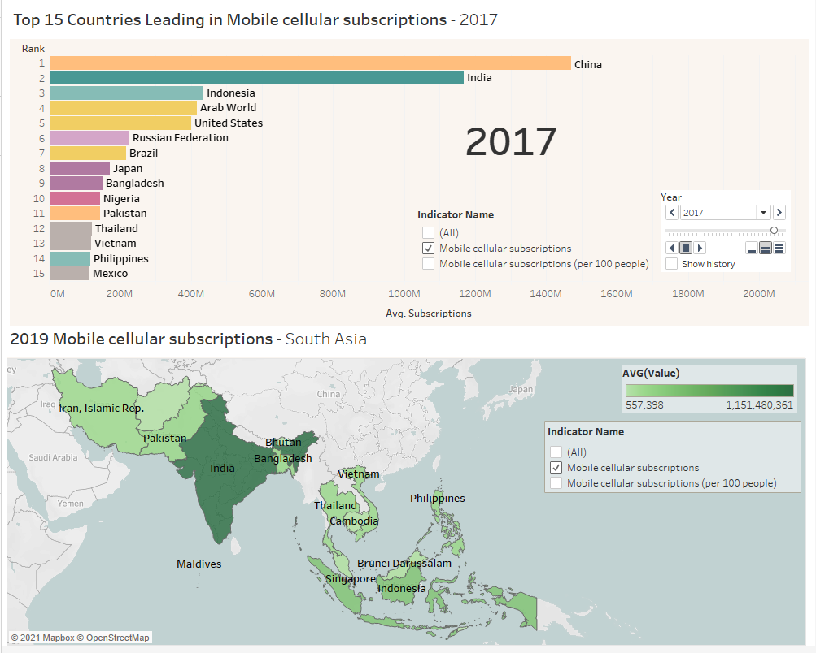
Notes:
Mobile Cellular Subscriptions
Saher Sohail

Slide 26
Results Mobile Cellular Subscriptions
1990
1st – US
2nd – UK
3rd – Japan
Pakistan – Not in top 15
2019
1st – China
2nd – India
3rd – Indonesia
Pakistan – 8th
South Asia (2019)
1st – India
2nd – Indonesia
3rd – Philippines
Lowest - Bhutan
Insight: US was in the lead in Mobile Cellular Subscriptions in the 1990s but by 2019 it was no where in the top 15, with leading countries being mainly Asian countries with highest populations with China taking the lead.

Slide 27
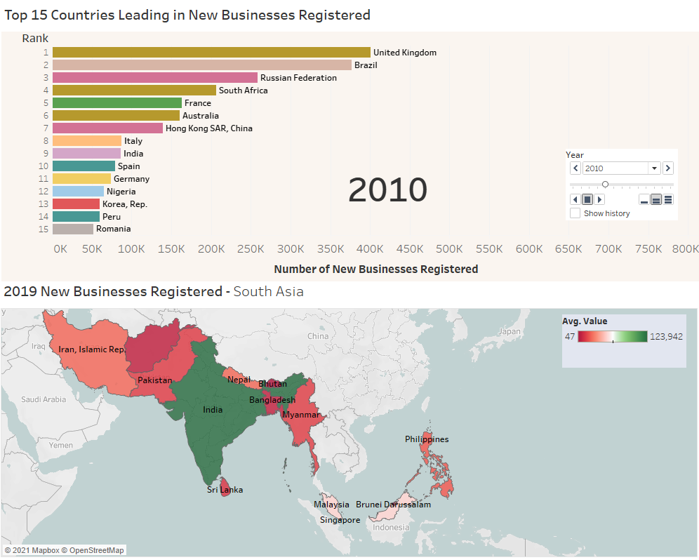
Notes:
New Businesses Registered
Usama Naveed

Slide 28
Results New Business Registered
1990
1st – Russia
2nd – UK
3rd – South Africa
Pakistan – 61th
2019
1st – UK
2nd – Russia
3rd – Australia
Pakistan – 56th
South Asia (2019)
1st – India
2nd – Malaysia
3rd – Singapore
Lowest - Afghanistan
Insights: It can be depicted from UK’s position that country offer good environment for new businesses. On the other hand Pakistan improved from 61th position to 56th which is quite slow.

Slide 29
Implementation Details
Tools
Tableau Desktop
Jupyter Notebook/ Google Colab
Python 3
Visualizations
Racing Bar Chart – Top 15 Countries
World Map – South Asian Countries
Bar Chart – Predicted Population
No machine learning algorithms were used since all required values are present in the dataset. We just need to filter out and group the required values with respect to the chosen indicators.
A new attribute “Rank” was created using the average of indicator values to rank the countries in the racing bar chart.
Visualization Tool
Data Preprocessing Tools

Slide 30
Summary of the Project
Used 2020 World Development Indicators dataset from Kaggle.
Visualization of 5 different indicators on Tableau. One per member.
2 different visualizations for the same indicator i.e. one static (world map) and one dynamic (racing bar chart)
We observed that mostly countries with higher population have a higher number of mobile cellular subscriptions.

Slide 31
Breakdown
Member | Tableau | Report | Presentation
Huma Ameer | ✓ | ✓ | ✓
M. Fasih Ashfaq | ✓ | ✓ | ✓
Nikhar Azhar | ✓ | ✓ | ✓
Saher Sohail | ✓ | ✓ | ✓
Usama Naveed | ✓ | ✓ | ✓

